Slide 1
Extrinsic material
Semiconductor

Slide 2
Introduction
A semiconductor to which an impurity at a controlled rate is added to make it conductive is known as an extrinsic semiconductor.
Contains impurities (donors, acceptors and traps )
The material properties are dominated by the concentration of the impurities and their effect on the crystal.
Usually n ≠ p

Slide 3
Type of Extrinsic Material
There are two type of extrinsic materials of immeasurable importance to semiconductor device fabrication.
N-type material
P-type material

Slide 4
n-Type Material
An n-type semiconductor is created when pure semiconductors, like Si and Ge, are doped with pentavalent elements.

Slide 5
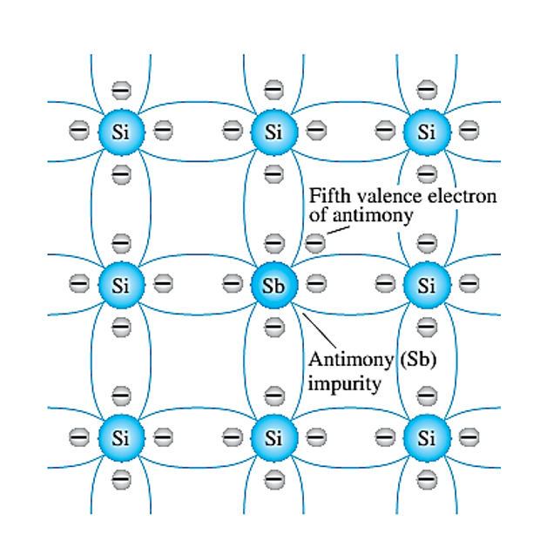
An n-type material is created by introducing impurity elements that have five valence electrons (pentavalents), such as antimony, arsenic and phosphorus. The effect of such impurity elements is indicated in given fig. We can see that four covalent bonds are still present. However, an additional fifth electron due to the impurity atom which is unassociated with any particular covalent bond. This remaining electron, loosely bound to its parent atom is relatively free to move within the newly formed n-type material.

Slide 6
P-Type Material
A p-type semiconductor is created when trivalent elements are used to dope pure semiconductors, like Si and Ge.

Slide 7
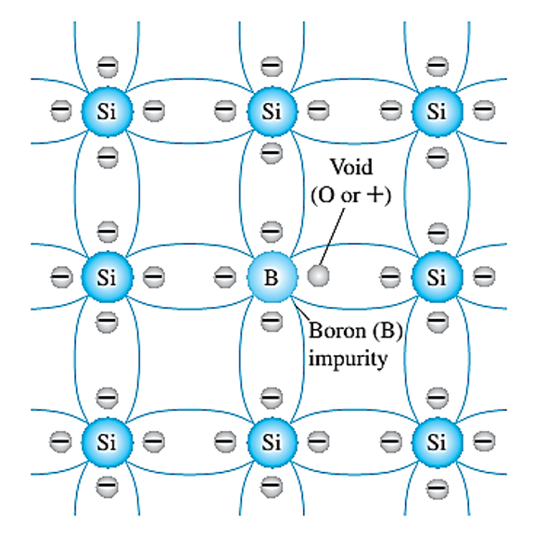
The p-type material is formed by doping a pure germanium or silicon crystal with impurity atoms having three valence electrons. The elements most frequently used for this purpose are boron, gallium and indium. There is an insufficient number of electrons to complete the covalent bonds of the newly formed lattice. The resulting p-type material is electrically neutral for the same reasons described for the n-type material.

